Slide 1
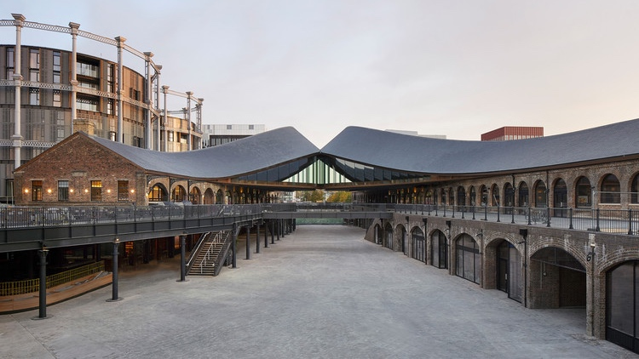
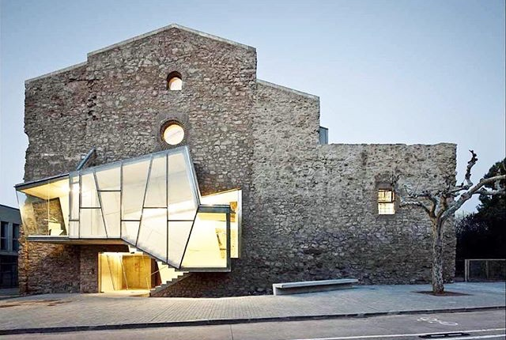

Old buildings,
new techniques:
How do buildings of the past fit into smart, sustainable cities for the future?
Rebecca Napolitano
Princeton University
Heritage Structures Lab
Structural Health Monitoring Lab

Slide 2
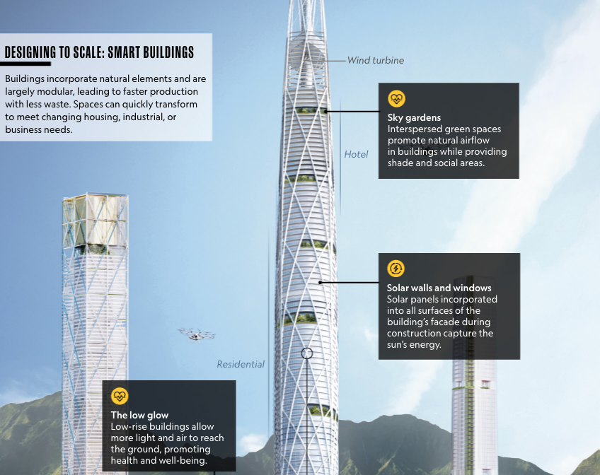
Google: smart, sustainable cities
(National Geographic, 2018)
Energy grid
Transportation
Waste management
Water resources
0

Slide 3




Working towards monitoring structural health at the urban-scale
Digital
replica
Physical
infrastructure
Digital twin
Predictions based on
present state
Prioritized
interventions

Slide 4
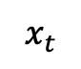
Working towards monitoring structural health at the urban-scale
Disturbance
Disaster impact Response impact
$$x_{t}$$
Community harm
Impact
Automatic detection
Wasted effort
Time
Impact
Improved outcomes
Low latency
Time

Slide 5



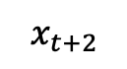
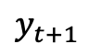
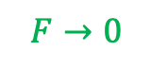

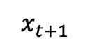

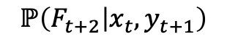

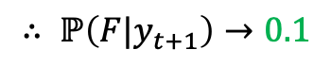
Working towards monitoring structural health at the urban-scale
Disturbance
Digital twin prediction
$$ℙ\left(F_{t+2} | x_{t},y_{t+1}\right)$$
$$x_{t}$$
@
Triggered sensor
$$∴$$
@
$$∴$$
$$∴$$
0
@
$$x_{t+1}$$
$$∴ ℙ\left(F|y_{t+1}\right)→0.1$$
Intervention
$$y_{t+1}$$
$$x_{t+2}$$
Result
$$F→0$$

Slide 6
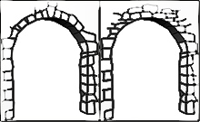
Background is in historic structures (lots of unknowns!)
And to understand them, we really have to bring together people from civil engineering, computer science, historic presrentation, archaeology, industry, etc. etc.
construction typologies we no longer use
deviations from the construction drawings
materials at unknown degradation state
interventions (which aren’t always documented)

Slide 7
Historic structures introduce unknowns into a network
Not highest potential for predictive power!
Less likely to be optimized and/or succeed!

Slide 8

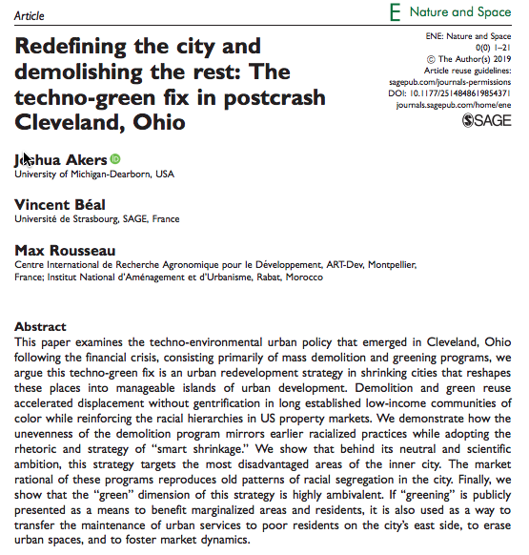
What should we do with historic infrastructure?

Slide 9
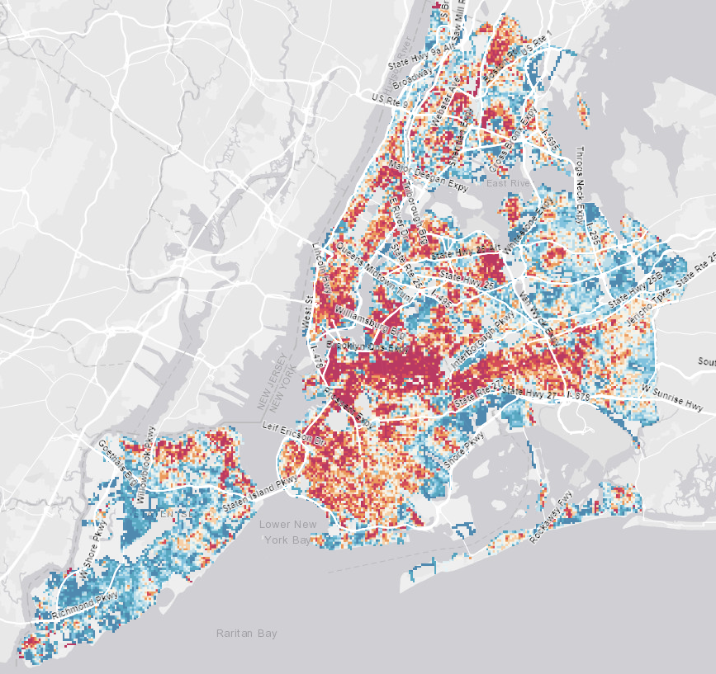
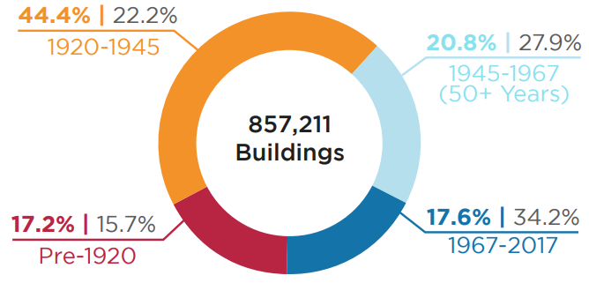
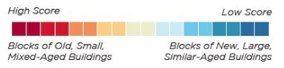
Historic structures are an ever-increasing part of building stock
New York City
82% > 50 years old
(Preservation Green Lab, 2016)

Slide 10
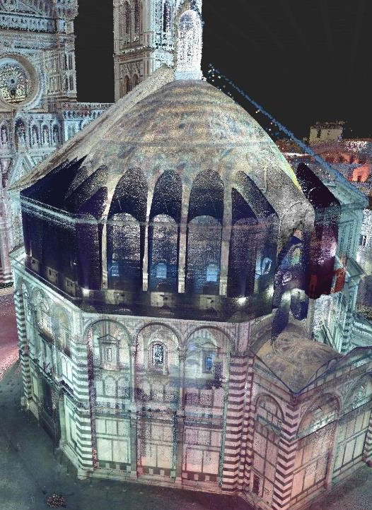
To address all of these unknowns…
During graduate school I have worked at the intersection of civil engineering, computer science, and historic preservation to develop new techniques for understanding what is going on inside an old building for trying to figure out creative ways we can figure out all of those unknowns and reduce the uncertainty of this large section of our building stock.

Slide 11
To address all of these unknowns…
How are aging structures functioning?
How can we integrate them into cities of the future?
During graduate school I have worked at the intersection of civil engineering, computer science, and historic preservation to develop new techniques for understanding what is going on inside an old building for trying to figure out creative ways we can figure out all of those unknowns and reduce the uncertainty of this large section of our building stock.

Slide 12



Diagnostics answers these questions and bridges the gap
Diagnostics
Aging structures
Smart, sustainable cities

Slide 13

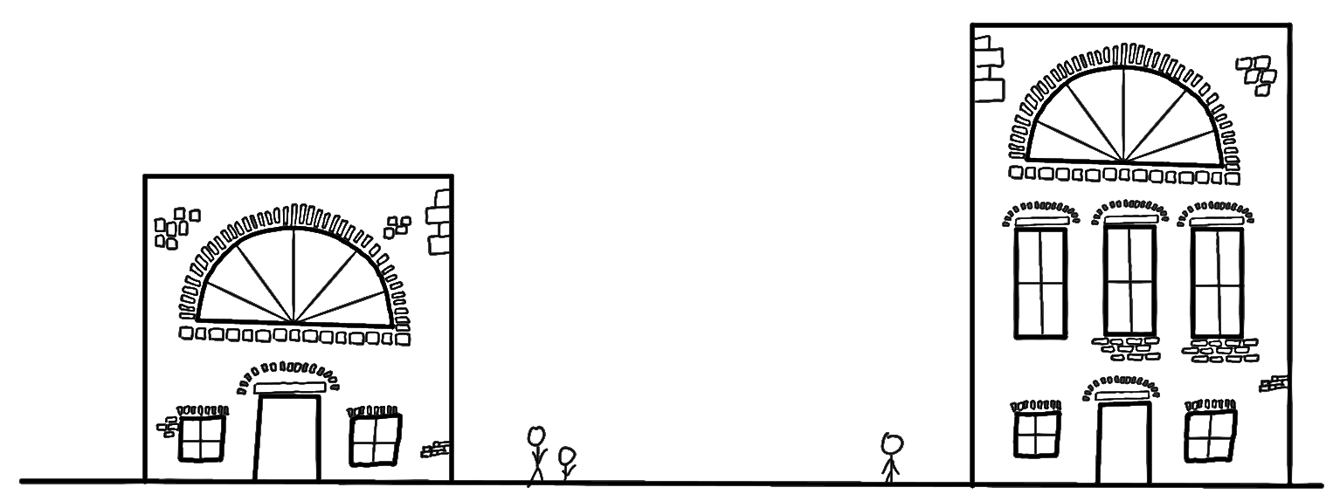



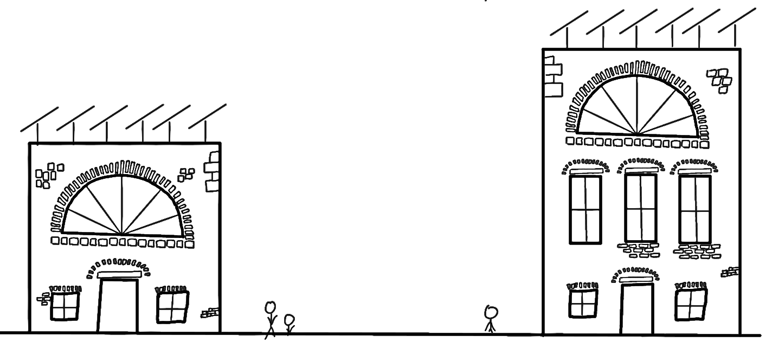


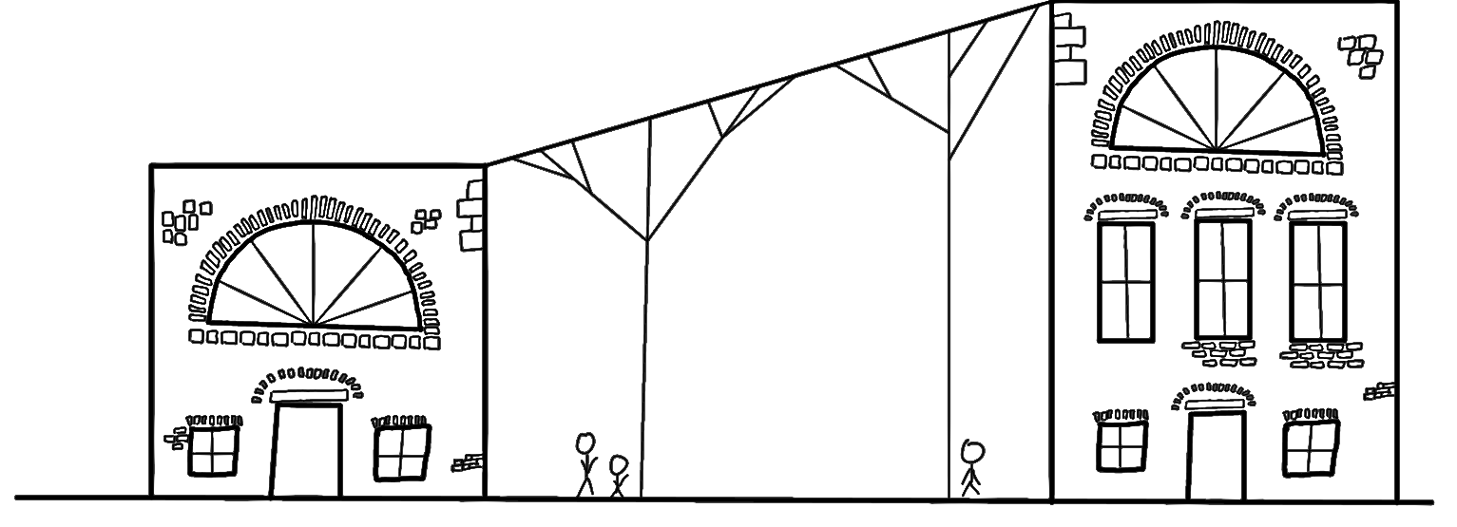
For this reason my research has focused on diagnostics
Data extraction
Preservation
Multi modal data fusion
Retrofitting
Hybrid analytics
Physics-based modeling
Diagnostics
Information modeling
Reuse
Diagnostics

Slide 14
For this reason my research has focused on diagnostics
Data extraction
Preservation
Multi modal data fusion
Retrofitting
Hybrid analytics
Physics-based modeling
Diagnostics
Information modeling
Reuse
Diagnostics

Slide 15
Today’s lesson
Take away:
To understand the current state of a building we need to quantitatively synthesize data from historic structures.
Skills
How to use regressions to see relationships between damages and causes
How to use factor analysis to see complex relationships between damages and multiple causes at once.

Slide 16
Exercise: Discuss systems diagram for final project with a partner
Identify:
in plan and in section indicators of damage on the wall (e.g. cracks, moisture)
specific things that can cause each damage (e.g. water running off roof?, earthquake region?, biological build up at drain?)
How can we tell what is contributing to the damage?
How can you monitor the damages and possible causes?
Color code your diagrams: Use colored lines between monitoring systems and possible causes

Slide 17
How can we understand relationships in this data?
i.e. Does rain intensity affect rising damp?
Two possible methods:
Regressions
Factor analysis
How much does it affect it compared to other factors?
Does the wind affect the rising damp more or less than the rain intensity? Etc.

Slide 18
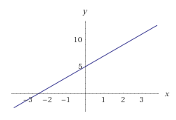
Regressions: linear
Y = mx+b
Y = dependent variable (Crack width)
M = slope (ie: for each in/hr the rain intensity increases, the crack grows 1 in)
X = independent variable (rain intensity)
B = y-intercept (ie: when there is no rain, the crack is ”b” mm wide
On your own, what is the equation on the right telling us?
When there is no rain, how big is the crack width?
When it is raining, how much does the crack width increase?
Crack width
(in)
Y = 2x + 5
Rain intensity
(in/hour)

Slide 19
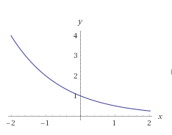
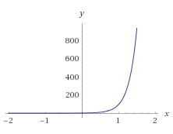
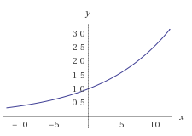
Regressions: exponential
Y = a^{x}
A = how quickly it grows/shrinks
If it is raining a 5 in/hour, what is the size of the crack width in each case?
Which of these makes sense and why? Which seem like errant readings?
Crack width
(in)
Crack width
(in)
Crack width
(in)
Y = 0.5^{x}
Y = 1.1^{x}
Y = 100^{x}
Rain intensity
(in/hour)
Rain intensity
(in/hour)
Rain intensity
(in/hour)

Slide 20
Regressions example in excel
Example in excel: calculationSheet.xlsx https://drive.google.com/file/d/1TWJmMLEw1aq7Yf_QAyDG5oWvYX1ryFvm/view?usp=sharing
Questions:
What values tell us what is happening in this wall?
What parameter captures both of those values?
Moisture content
How can we find the mc for a given RH and T?
Psychrometric charts
Empirically derived formulae
What values are most correlated with what we are seeing in the wall?
What does the equation tell us?
Any other interesting trends we are seeing?
What does this not account for?
Notes:
Formula reference: https://www.wagnermeters.com/moisture-meters/wood-info/what-is-equilibrium-moisture-content/

Slide 21

Factor analysis versus regressions
How regressions handle the data:
How the data actually functions

Slide 22
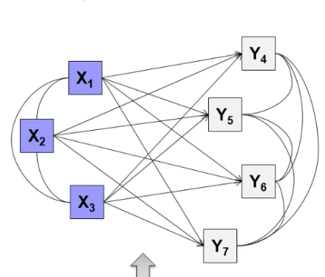
Factor analysis
Y = mx+b; R²
Y = mx+b; R²
Y = mx+b; R²
Y = mx+b; R²
Y = mx+b; R²

Slide 23
Factor analysis example in python
Example in python:
https://github.com/rkn2/factorAnalysisExample/blob/master/FactorAnalysisPersonality.ipynb
Application to case study data:
https://github.com/rkn2/factorAnalysisExample/blob/master/FactorAnalysis.ipynb

Slide 24
Exercise: Factor analysis and your systems diagrams
How do we represent things that could be working together in your systems diagram?
Reinforcing and balancing feedback loops
What could be functioning together in your diagram?

